Slide 1
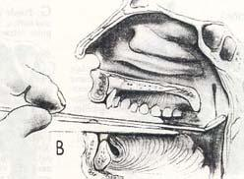
Posterior rhinoscopy

Slide 2
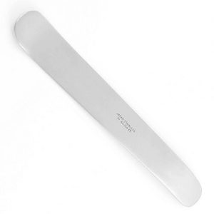
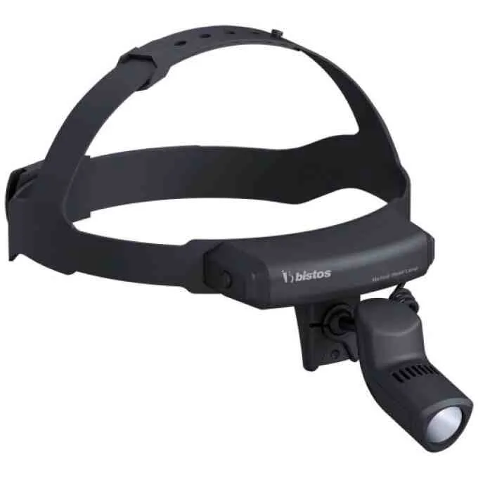
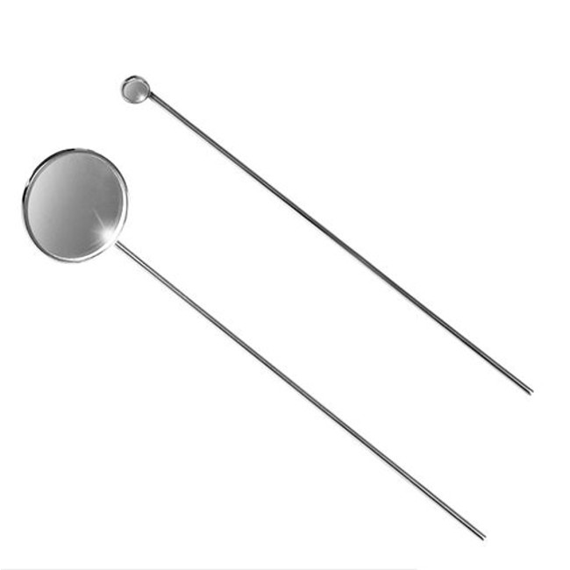

Slide 3
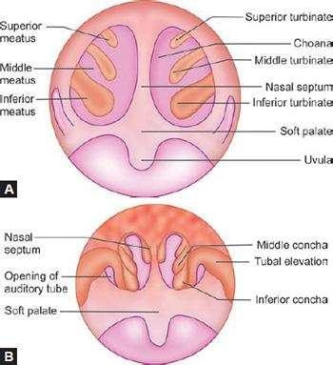
What we examine:
Nasopharynx (cavum)
Openings of the Eustachian tubes
Choanal openings
Pharyngeal tonsil (Luschka’s tonsil)
Tubal tonsil (Gerlach’s tonsil)
Nasopharyngeal mucosa
Nasal turbinates

Slide 4

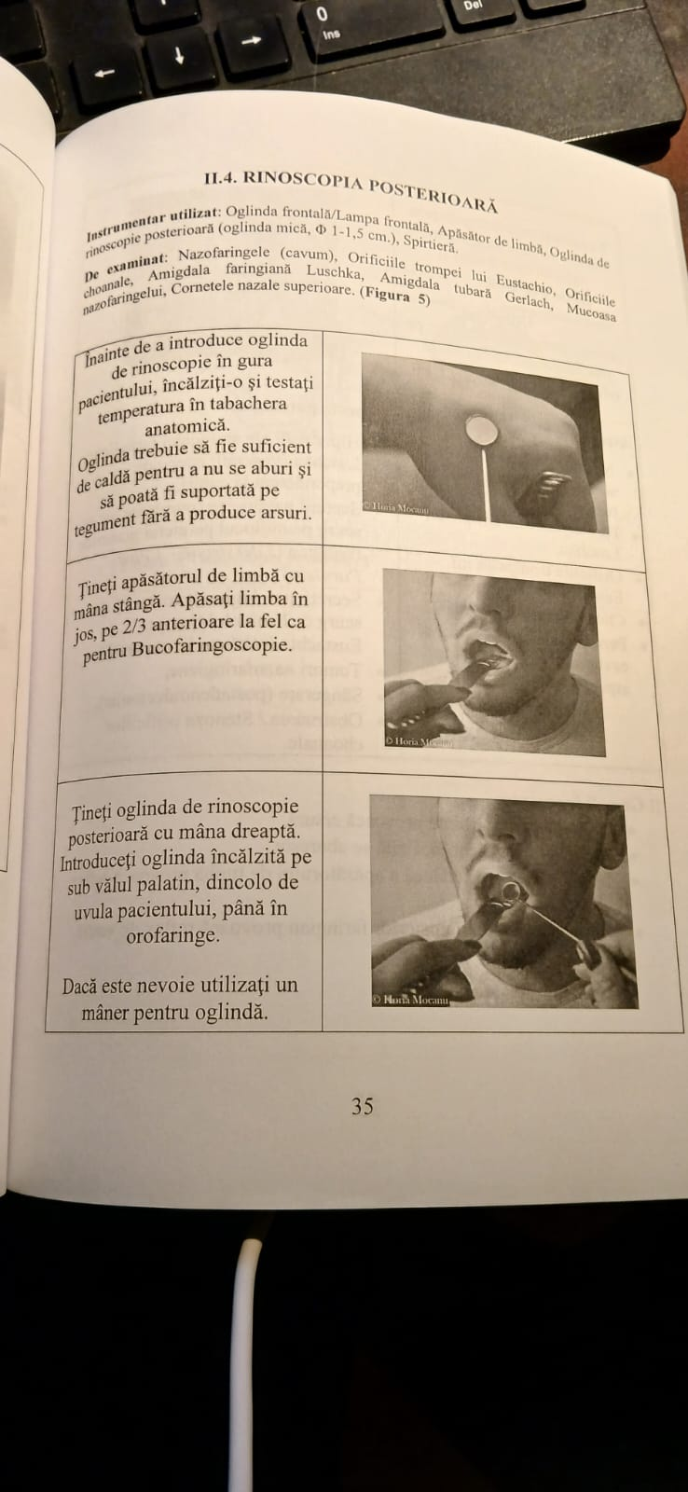
Before inserting the rhinoscopy mirror into the patient’s mouth, warm it and test the temperature on the anatomical snuffbox.
The mirror should be warm enough to prevent fogging, yet tolerable to the skin without causing burns.

Slide 5
Hold the tongue depressor with your left hand. Press the tongue down on its anterior two-thirds, as for buccopharyngoscopy.
Hold the posterior rhinoscopy mirror with your right hand. Insert the warmed mirror beneath the soft palate, past the patient’s uvula, into the oropharynx

Slide 6
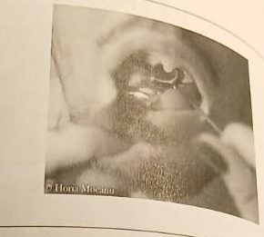
Examine the nasopharynx by gently tilting the mirror laterally and posteriorly.
Tip: Instruct the patient to breathe through their nose. This relaxes the soft palate and facilitates the examination.

Slide 7
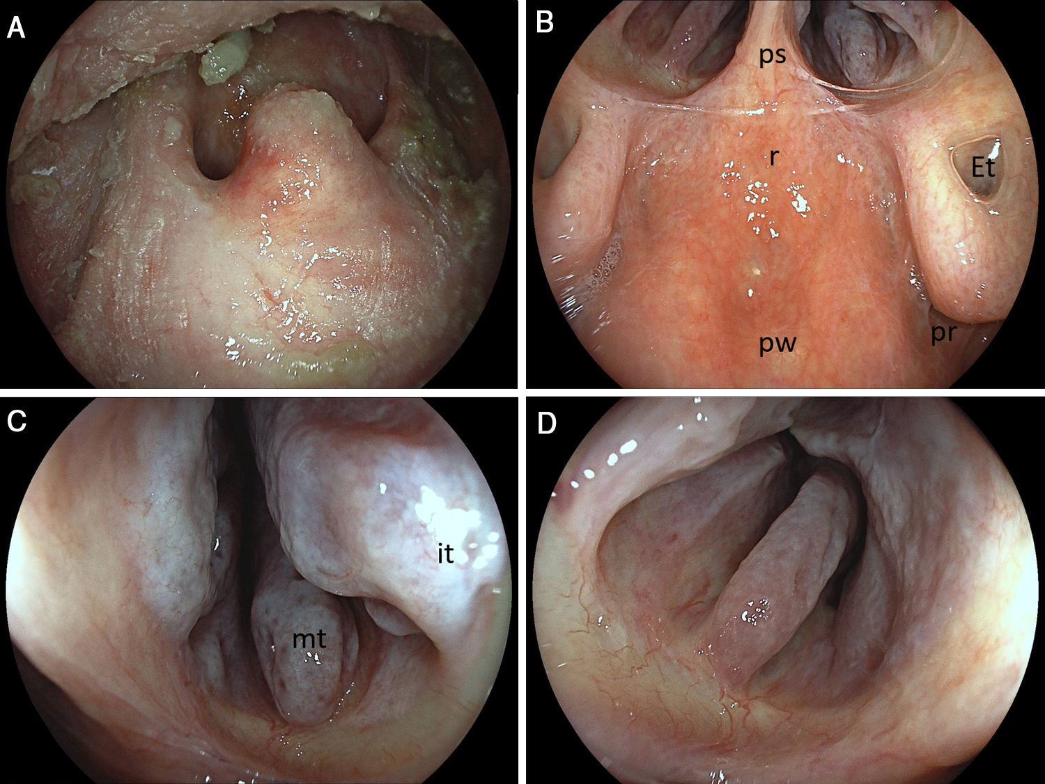
Normal aspects:
Clear nasopharynx, with no pathological secretions or tumors,
No hypertrophy of Luschka’s tonsil,
Eustachian tube openings are patent,
Nasal choanae are clear,
The posterosuperior wall of the cavum and the mucosa appear normal.

Slide 8
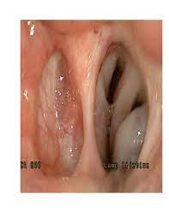
Pathological aspects
Hypertrophy of the pharyngeal tonsil (Luschka’s tonsil / adenoids – common in children)
Pathological (purulent) secretions flowing down the posterior pharyngeal wall (Eiterstraße – “pus trail”)
Purulent secretions from the Eustachian tube opening (suggestive of suppurative otitis media)
Nasopharyngeal tumors
Bleeding (post-adenoidectomy)
Choanal obstruction / stenosis

Slide 9
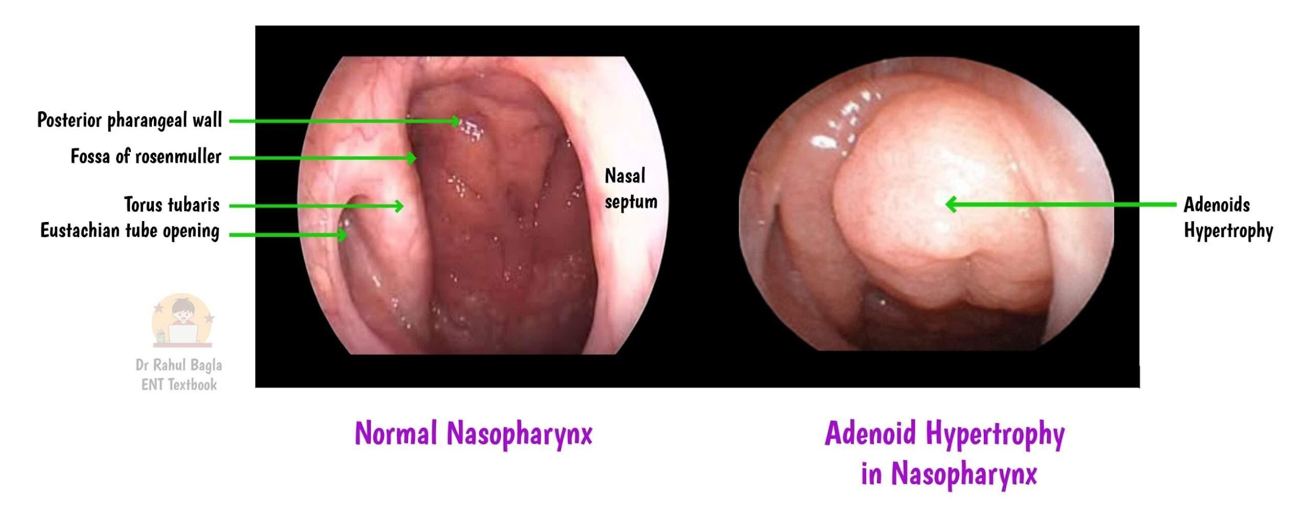

Slide 10
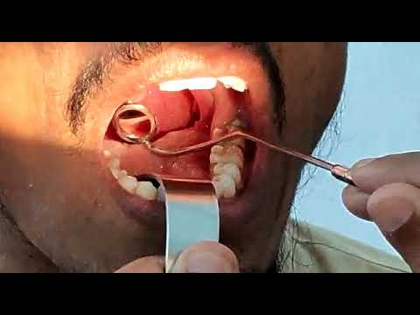
Common mistakes :
An overheated mirror can cause burns.
An insufficiently warmed mirror will fog up.
Inserting the tongue depressor too deeply triggers the gag reflex.
Touching the posterior pharyngeal wall triggers the gag reflex.

Slide 11
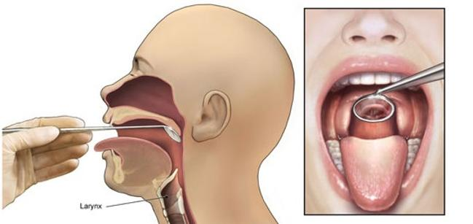
Indirect laryngoscopy

Slide 12
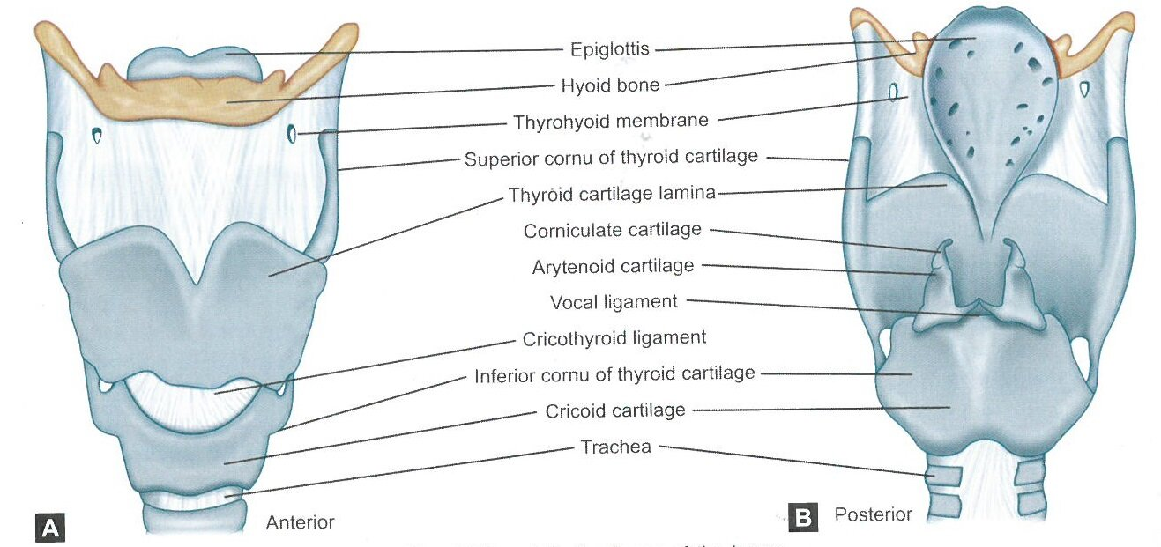

Slide 13
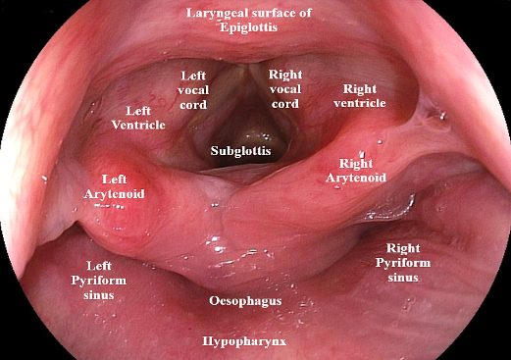

Slide 14
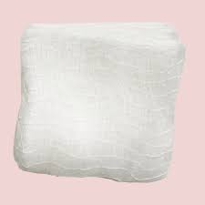

Slide 15
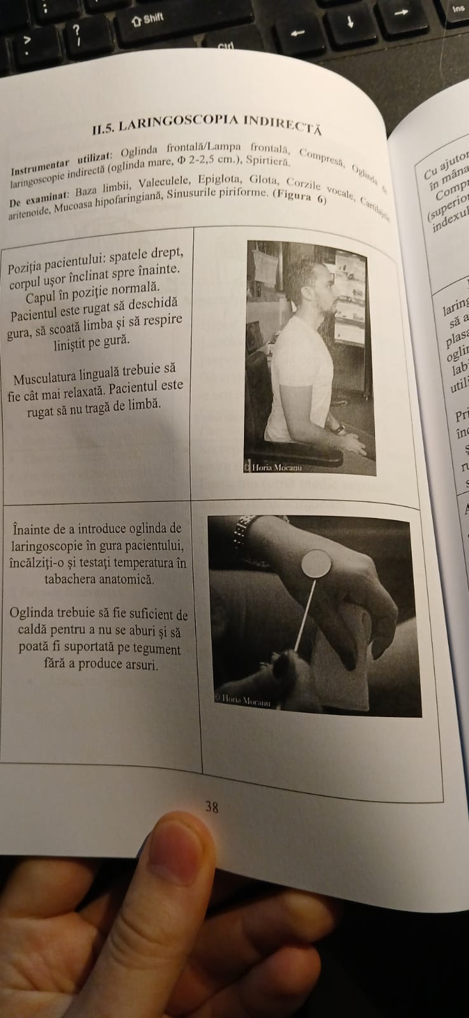
The back should be straight, with the torso slightly leaning forward.
The head remains in a neutral position.
The patient is asked to open their mouth, stick out the tongue, and breathe calmly through the mouth.
The tongue muscles should be as relaxed as possible. The patient is instructed not to pull on the tongue.

Slide 16
Before inserting the laryngeal mirror into the patient's mouth, heat it up and test the temperature on the anatomical snuffbox.
The mirror must be warm enough to prevent fogging, but still tolerable on the skin so as not to cause burns.

Slide 17
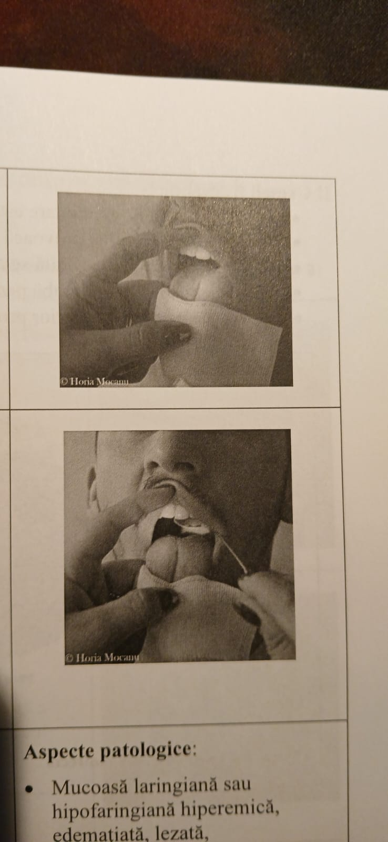
Using a soft gauze pad in your left hand, hold the tongue.
The gauze is held between the thumb and middle finger. Use the index finger to lift the upper lip.

Slide 18
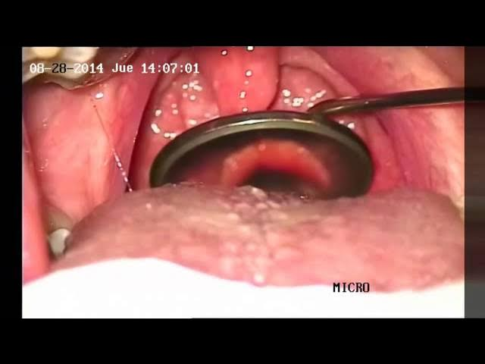
Insert the laryngeal mirror while avoiding contact with surrounding structures and without pressing on the root of the uvula.
The mirror handle should rest on the left corner of the mouth. If necessary, use a dedicated handle for the mirror.
With gentle rotating and tilting movements, examine the larynx and hypopharynx.
Ask the patient to take a deep breath, then pronounce the vowels "E" and "I" slowly.

Slide 19
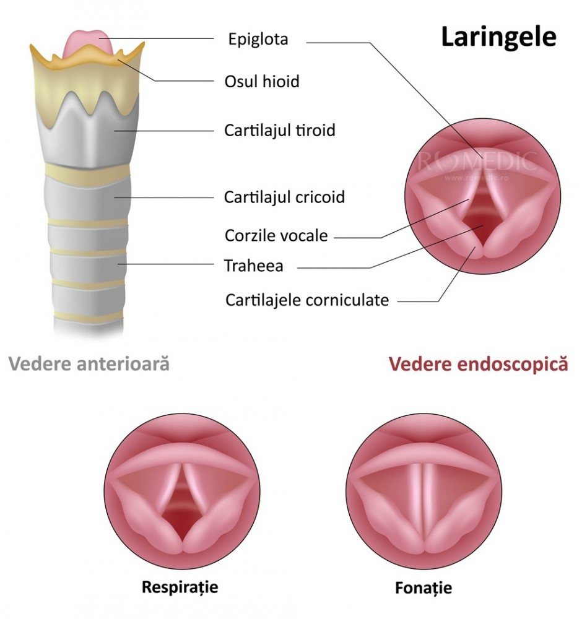
Normal aspects:
The base of the tongue, epiglottis, valleculae, piriform sinuses, oropharynx, and hypopharynx appear normal, without edema, hyperemia, or mucosal lesions, and without foreign bodies or tumor formations.
Vocal cords have normal shape and coloration.
Bilateral vocal cord mobility is preserved and symmetrical.
The first tracheal cartilages appear normal.

Slide 20
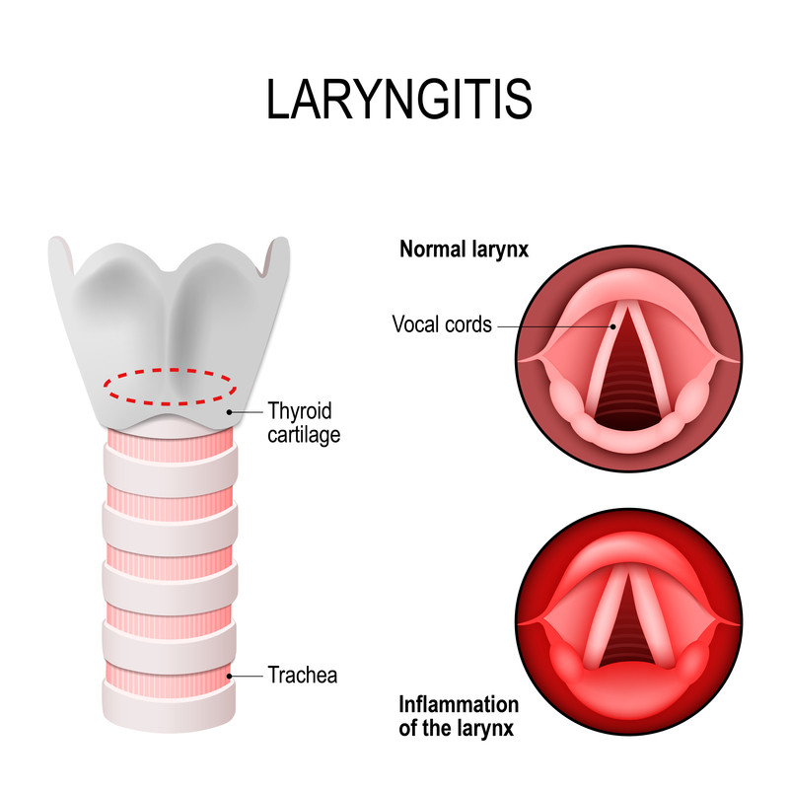
Pathological aspects :
Hyperemic, edematous (injured) laryngeal or hypopharyngeal mucosa
Epiglottic edema
Foreign bodies
Pathological secretions (purulent, blood-streaked)
Laryngeal or hypopharyngeal tumors
Edema, hyperemia
Unilateral or bilateral vocal cord immobility or paralysis

Slide 21
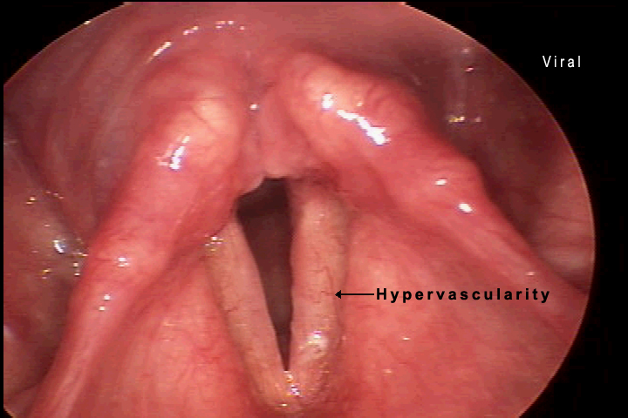
Laryngitis (acute/chronic/gastroesophageal reflux-related)

Slide 22
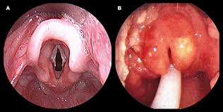
Epiglottitis

Slide 23
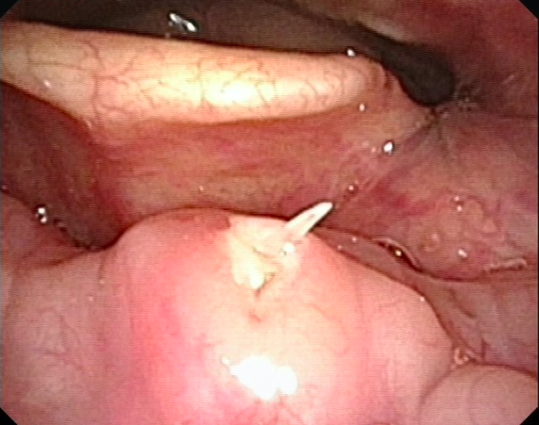
Foreign Bodies

Slide 24
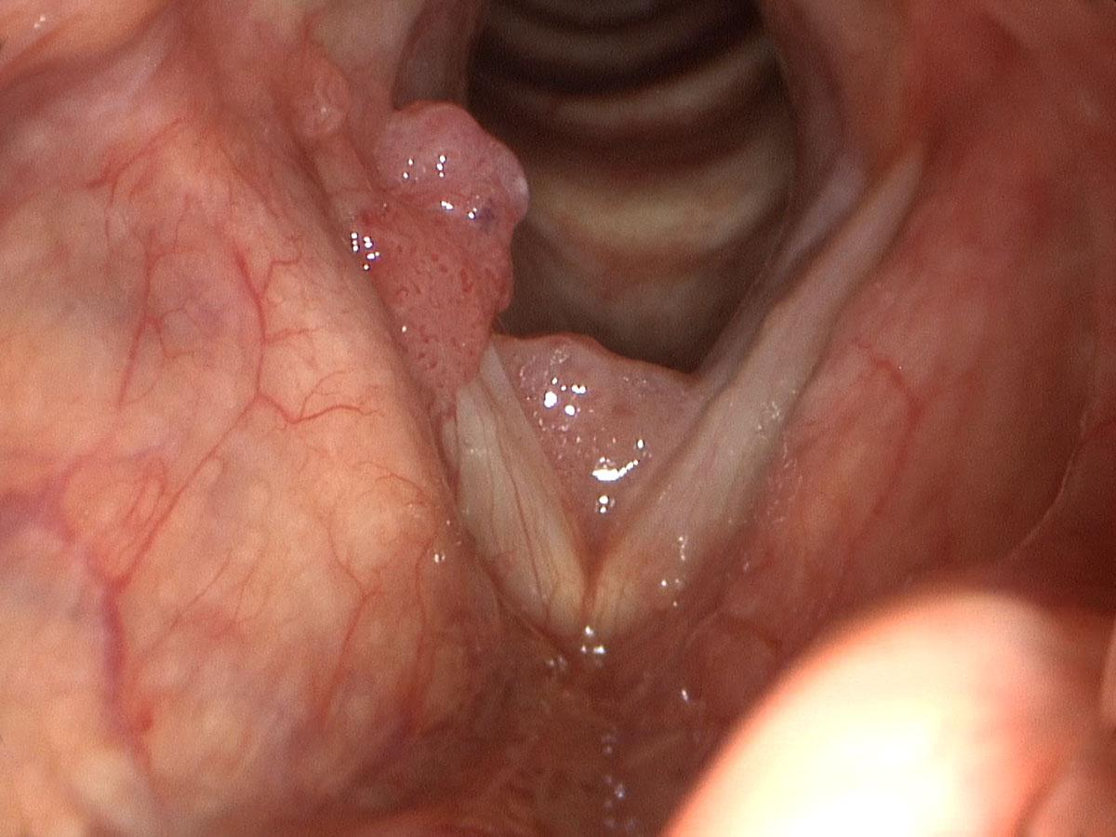
Laryngeal Papillomas

Slide 25
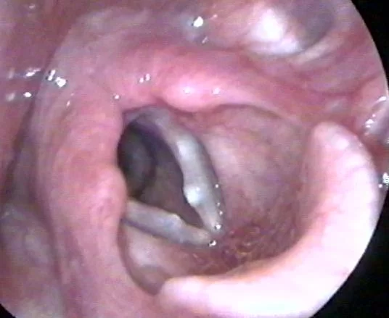
Vocal nodules ("singer's nodules")

Slide 26
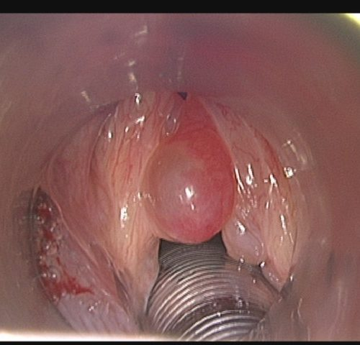
Vocal cord polyps

Slide 27
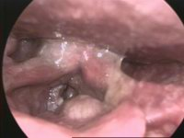
Laryngeal cancer

Slide 28
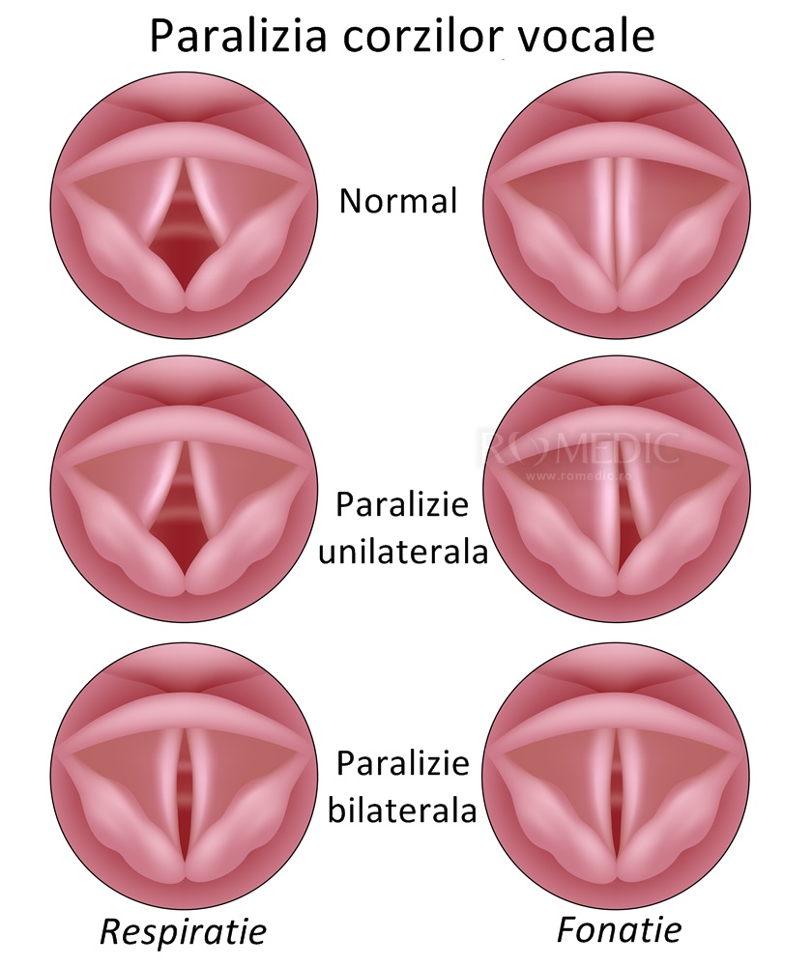
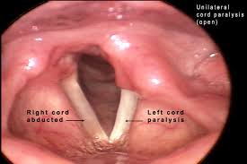
Unilateral or bilateral vocal cord immobility or paralysis

